Slide 1
Teacher Eliane Cavalher S. Rossi – elianecavalher@gmail.com
Present Continuos
Press F5 to start, then click to show the next answer
Follow the first examples and try to ask orally, guessing the answers according to the picture

Slide 2
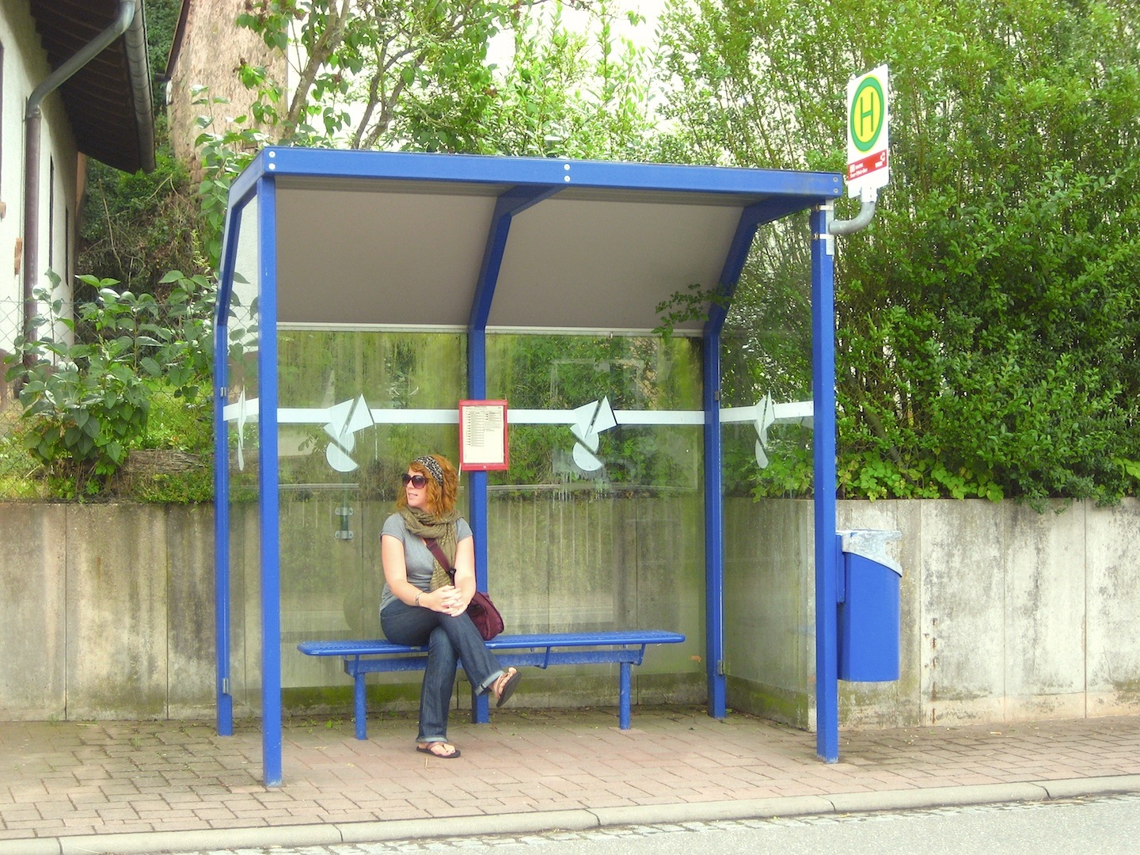
What is she doing?
She is waiting for the bus

Slide 3
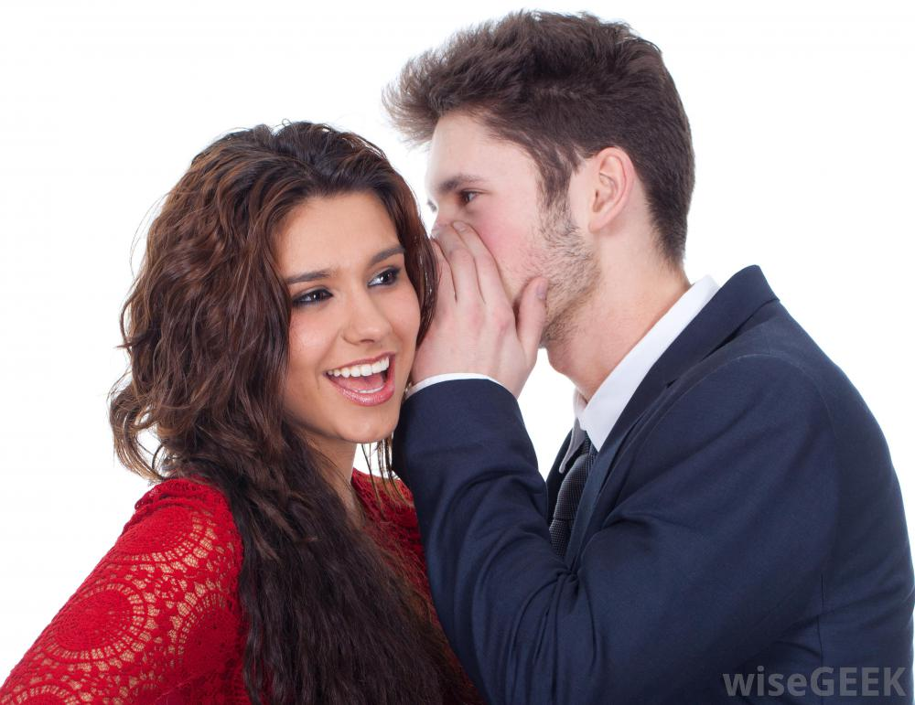
What is he doing?
He is telling her a secret or...
He is telling a secret to her

Slide 4
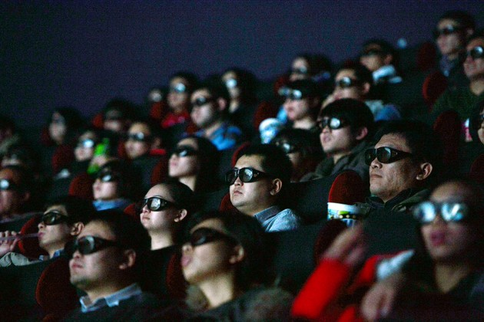
What are they doing?
They are seeing a film/ movie

Slide 5
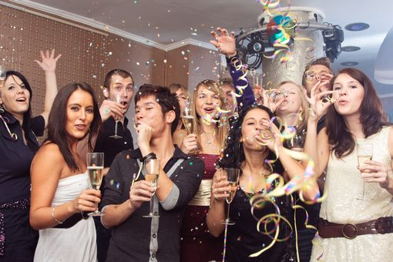
What are they doing?
They are having a party

Slide 6
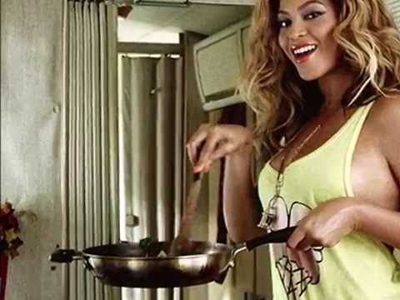
What is she doing?
She is cooking

Slide 7
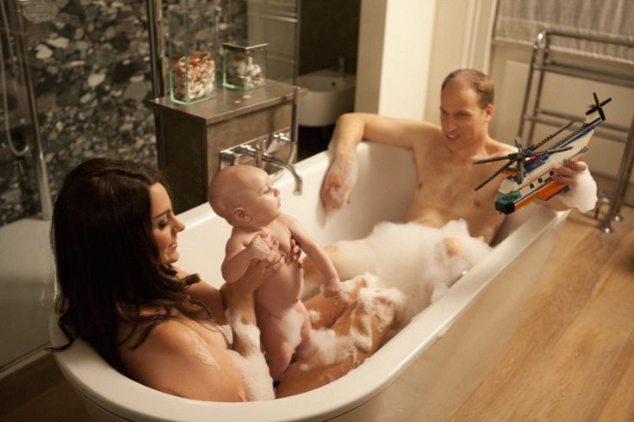
What are they doing?
They are having a bath

Slide 8
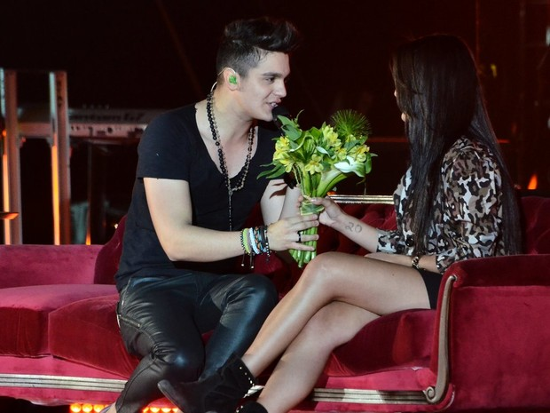
What is he doing?
He is giving her flowers or...
He is giving flowers to her

Slide 9
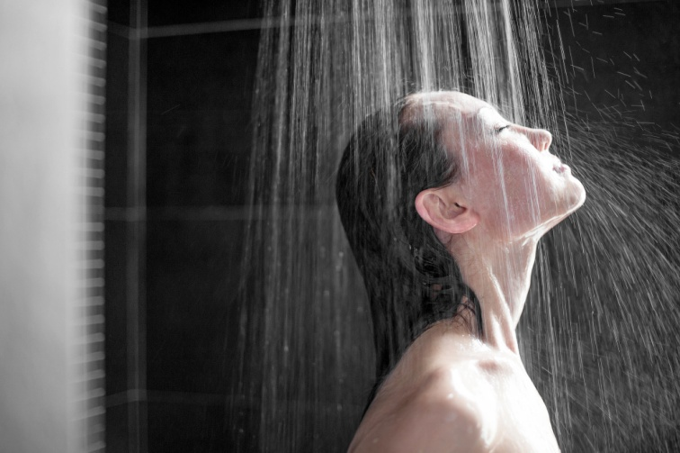
What is she doing?
She is taking/having a shower

Slide 10
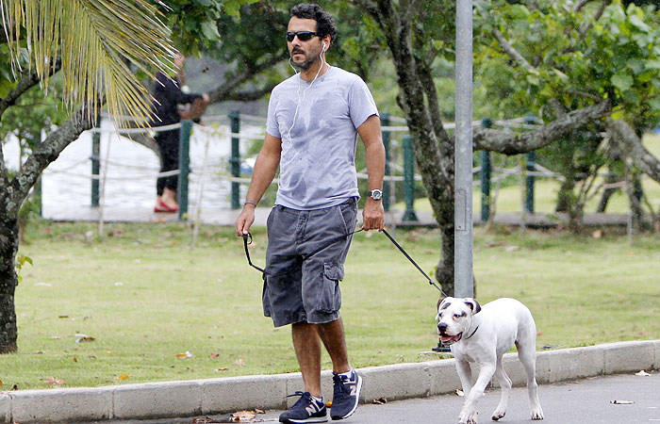
What is he doing?
He is taking the dog for a walk/
He is walking his dog

Slide 11
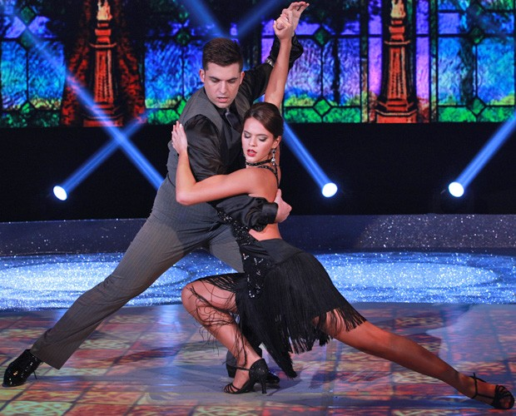
What are they doing?
They are dancing the tango

Slide 12
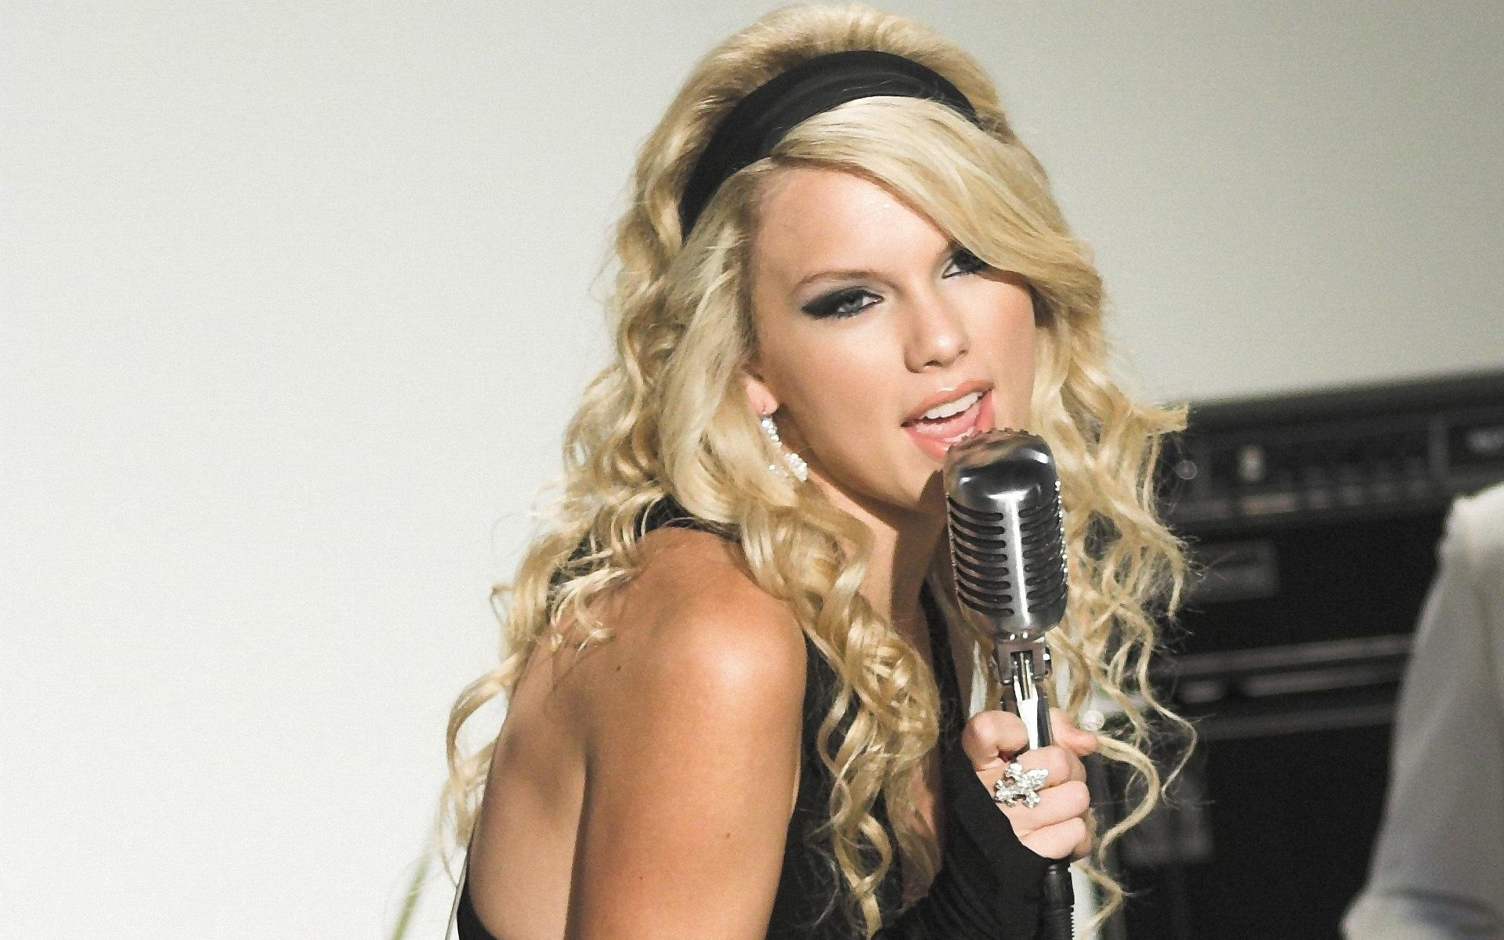
What is she doing?
She is singing

Slide 13
What is he doing?
He is riding a bike

Slide 14
What is she doing?
She is washing the dishes or...
She is doing the washing up

Slide 15
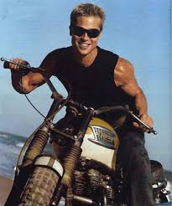
What is he doing?
He is riding a motorbike

Slide 16
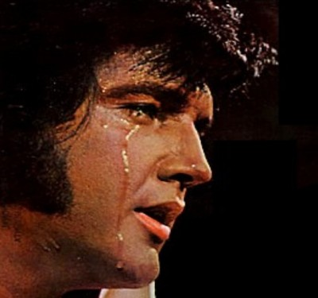
What is he doing?
He is crying

Slide 17
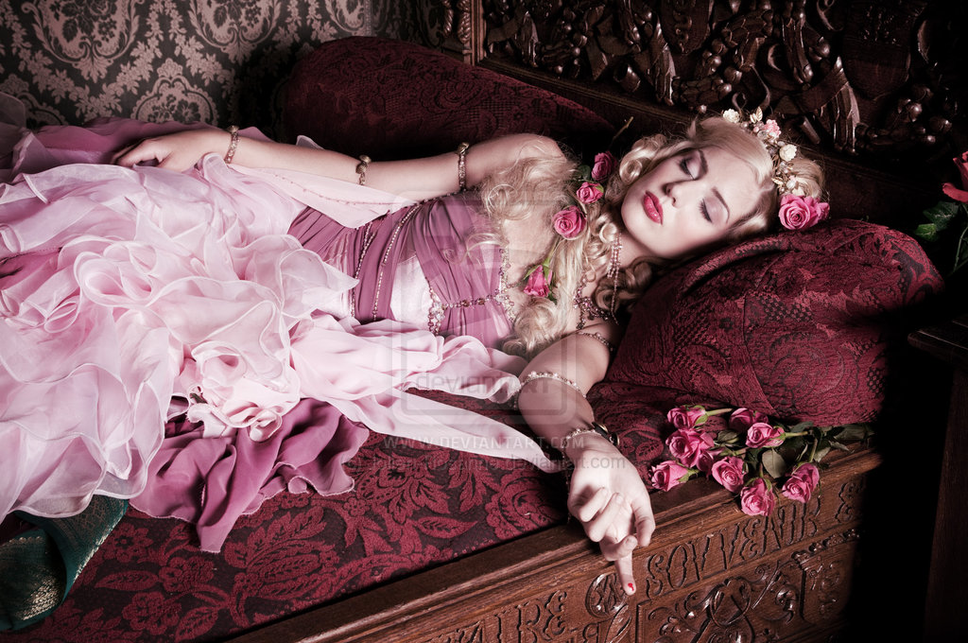
What is she doing?
She is sleeping

Slide 18
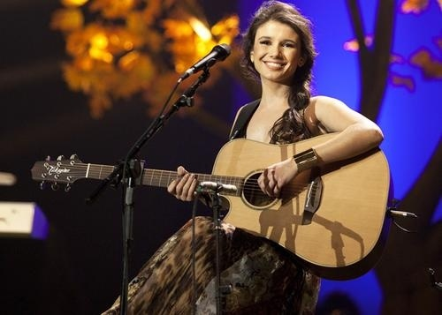
What is she doing?
She is playing the guitar

Slide 19
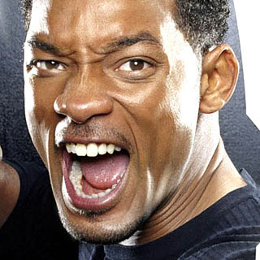
What is he doing?
He is shouting

Slide 20
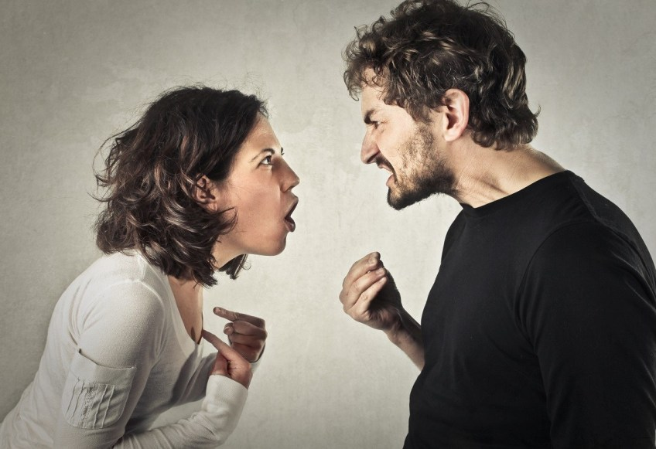
What are they doing?
They are arguing

Slide 21
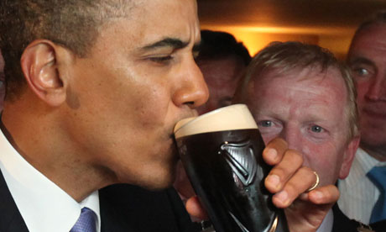
What is he doing?
He is drinking/having draftbeer

Slide 22
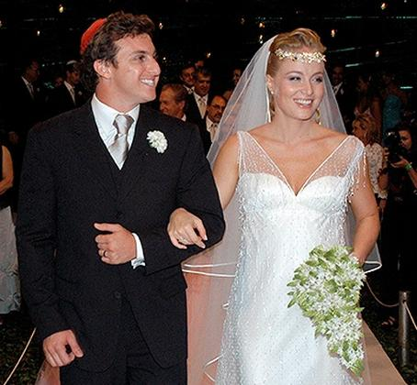
What are they doing?
They are getting married

Slide 23
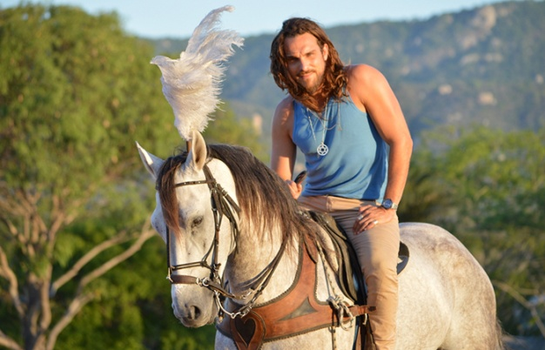
What is he doing?
He is riding a horse

Slide 24
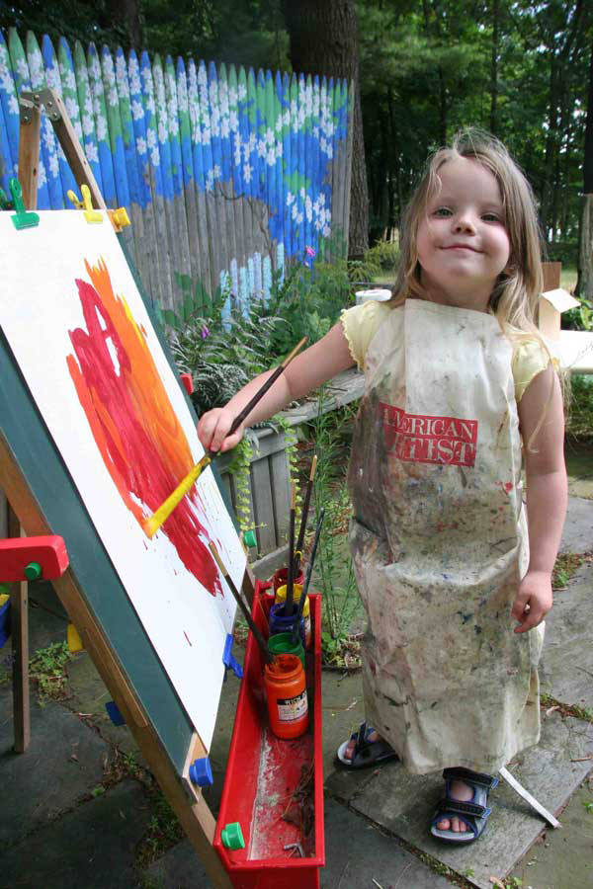
What is she doing?
She is painting a picture

Slide 25
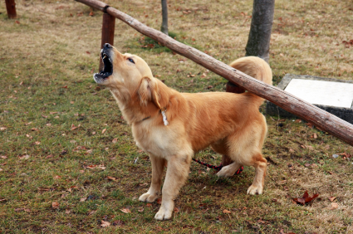
What is the dog doing?
It is barking

Slide 26
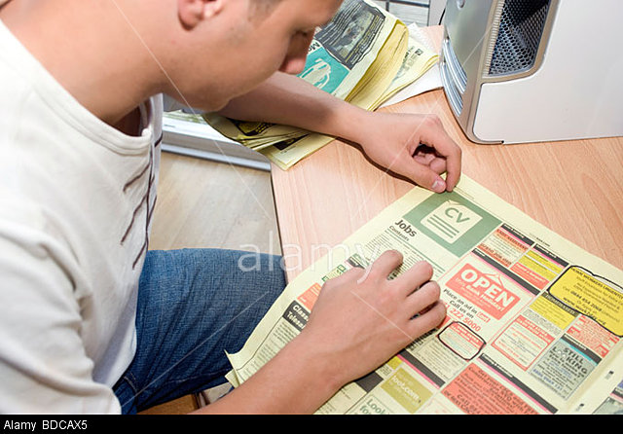
What was he doing?
He was looking for a job

Slide 27
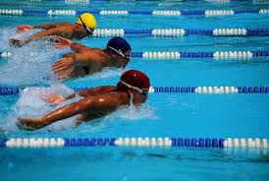
What are they doing?
They are swimming

Slide 28
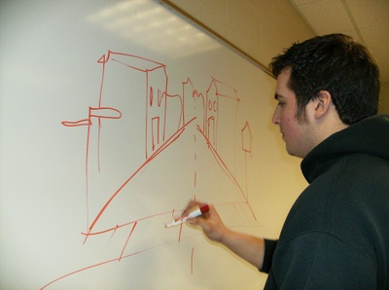
What is he doing?
He is drawing

Slide 29
What is she doing?
She is buying shoes
She is shoeshopping
She is shopping for shoes

Slide 30
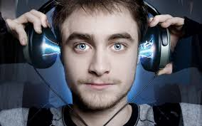
What is he doing?
He is listening to music

Slide 31
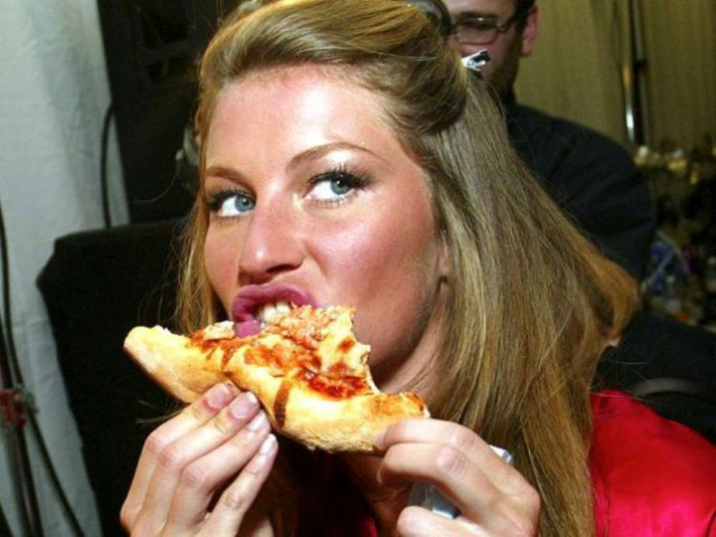
What is she doing?
She is eating/ having a pizza

Slide 32
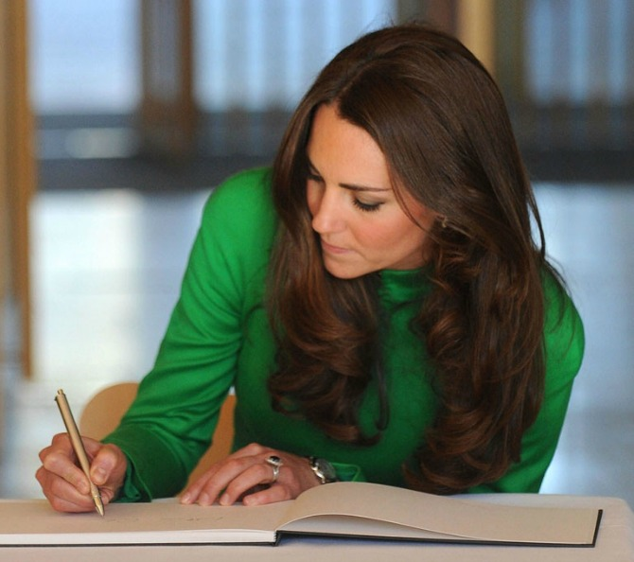
What is she doing?
She is writing

Slide 33
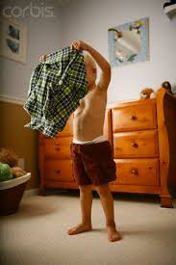
What is he doing?
He is getting dressed

Slide 34
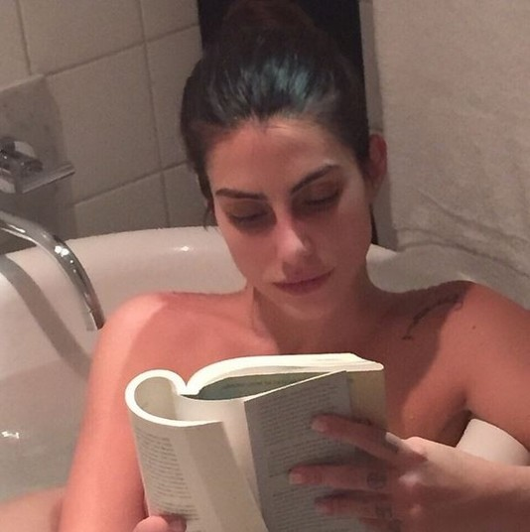
What is she doing?
She is reading

Slide 35
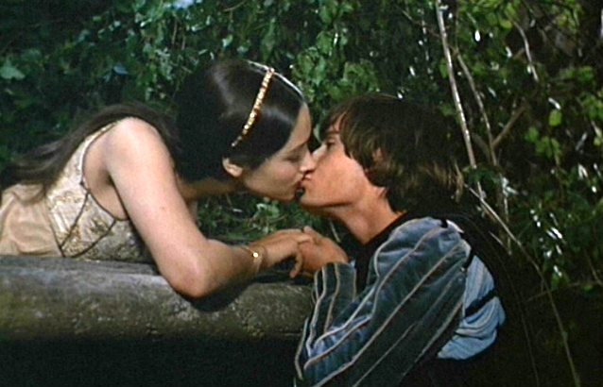
What are they doing?
They are kissing

Slide 36
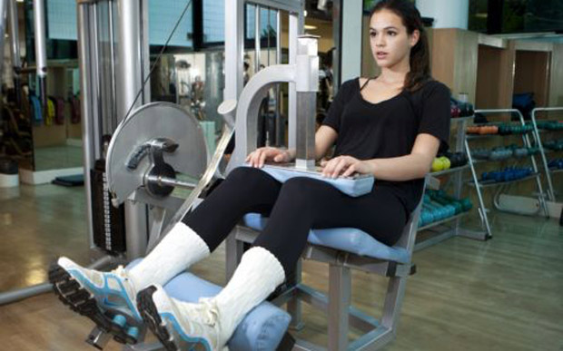
What is she doing?
She is doing exercise

Slide 37
THE END
By Eliane Cavalher S. Rossi

